Slide 1

Analysis of trends and patterns in TV series data
A Comprehensive Study Using IMDb Datasets

Slide 2
Introduction
- Objective: Explore trends in TV series production, ratings, and genres over time.
- Datasets Used:
• title.basics.tsv.gz (923 MB)
• title.ratings.tsv.gz (25 MB)
- Methodology:
• Data Cleaning and Preprocessing.
• Statistical Analysis and Visualizations.

Slide 3
Data Preprocessing
- Filtered for tvSeries and tvMiniSeries.
- Cleaned invalid entries (\N) and transformed columns.
- Merged datasets using the unique identifier (tconst).

Slide 4
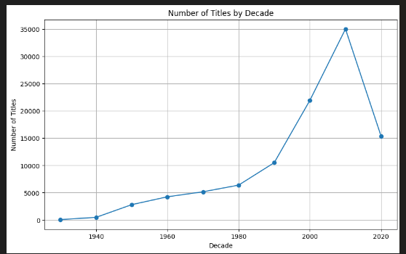
Analysis of TV Series Production
- Significant increase in series production post-1960.
- Peak production during the 2000s and 2010s.

Slide 5
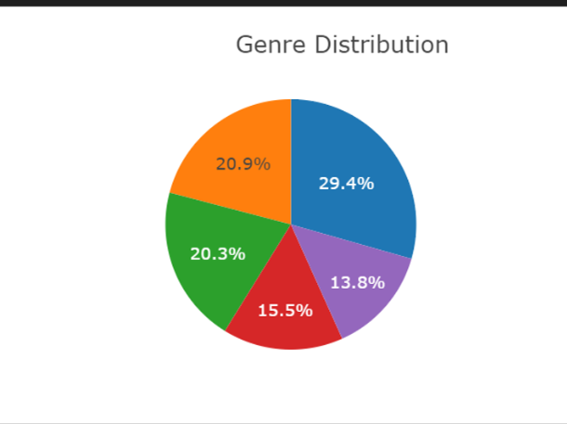
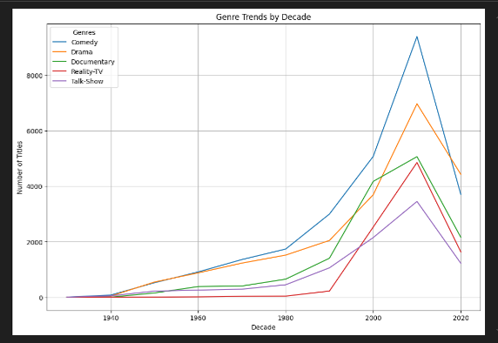
Genre Popularity
- Comedy, Drama, and Reality-TV are consistently popular.
- Rise of multi-genre series like Drama-Comedy.

Slide 6
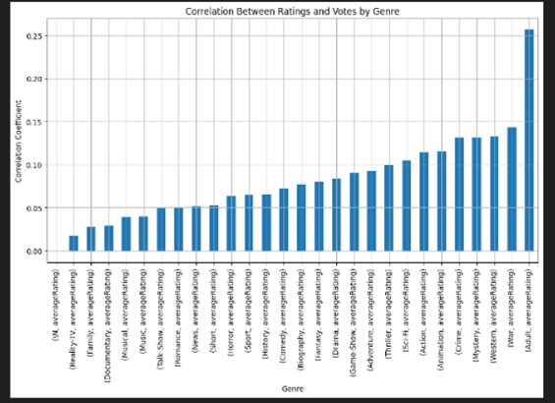
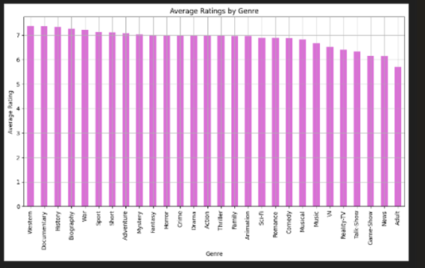
Ratings Analysis
- Documentary and Western genres have the highest average ratings.
- Weak correlation between popularity (votes) and ratings.

Slide 7
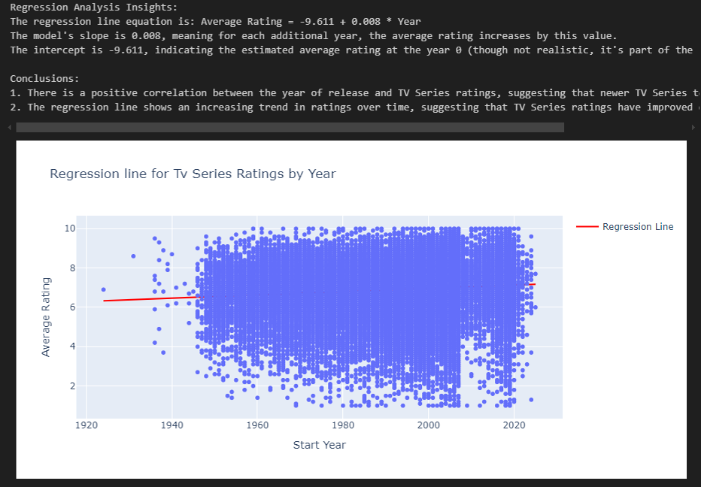
Temporal Trends in Ratings
- Positive correlation between release year and average ratings.
- Regression line shows a trend of newer series receiving higher ratings.

Slide 8
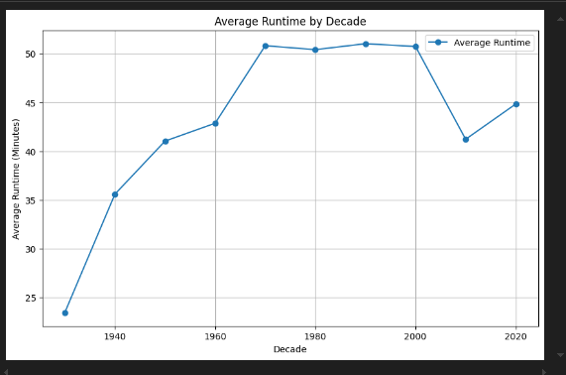
Runtime and Lifespan Analysis
- Runtime Trends: Increase in average runtime from the 1980s onward.
- Lifespan Trends: Series lifespan peaked in the mid-20th century but declined in recent decades.

Slide 9
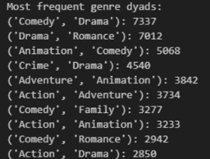
Genre Co-occurrence Patterns
- Commonly paired genres include Drama-Comedy and Drana-Romance.

Slide 10
Visual Summary
Showcase all major graphs, such as:
- Production trends.
- Genre distribution.
- Ratings trends over time.

Slide 11
Conclusion
- Production volumes have surged in recent decades.
- Comedy and Drama remain evergreen genres.
- Viewer preferences and production quality have evolved positively over time.

Slide 12
Future Directions
- Explore the impact of streaming platforms on series production.
- Examine demographic data for deeper insights into viewer preferences.
- Conduct cross-cultural analyses.

